Slide 1
Organizational Structure and Design

Slide 2
Purposes of Organizing
Divides work to be done into specific jobs and departments.
Assigns tasks and responsibilities associated with individual jobs.
Coordinates diverse organizational tasks.
Clusters jobs into units.
Establishes relationships among individuals, groups, and departments.
Establishes formal lines of authority.
Allocates and deploys organizational resources.

Slide 3

Organizational Structure
Work Specialization
  The degree to which tasks in the organization are divided into separate jobs with each step completed by a different person.
  Overspecialization can result in human diseconomies from boredom, fatigue, stress, poor quality, increased absenteeism, and higher turnover.

Slide 4
Departmentalization by Type
Functional
  Grouping jobs by functions performed
Product
  Grouping jobs by product line
Geographical
  Grouping jobs on the basis of territory or geography
Process
  Grouping jobs on the basis of product or customer flow
Customer
  Grouping jobs by type of customer and needs

Slide 5
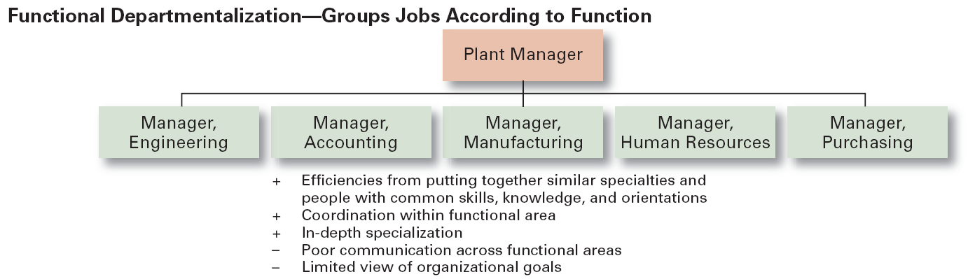
The Five Common Forms of Departmentalization

Slide 6
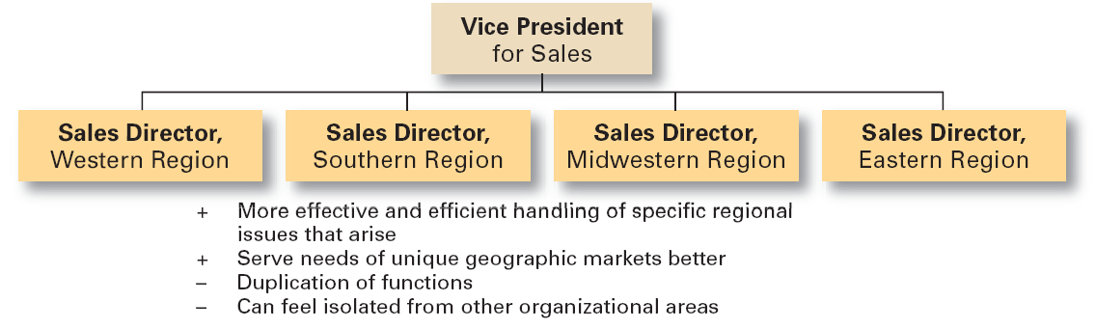
Geographical Departmentalization

Slide 7
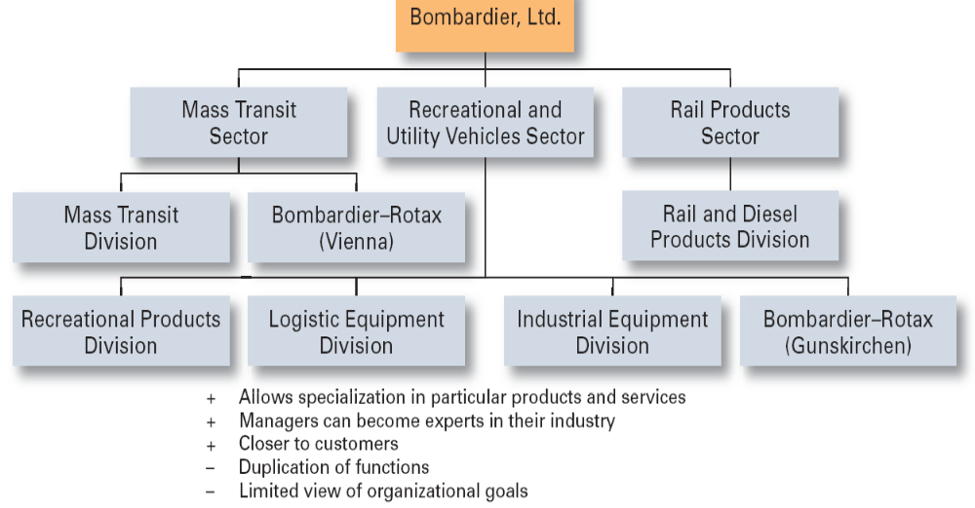
Product Departmentalization

Slide 8
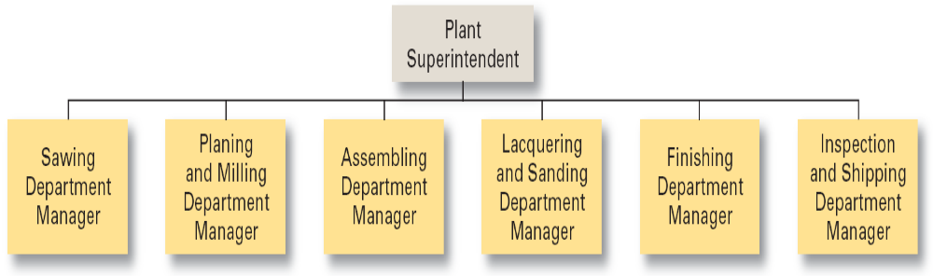
Process Departmentalization
+ More efficient flow of work activities
– Can only be used with certain types of products

Slide 9
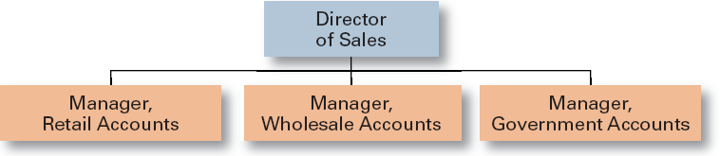
Customer Departmentalization
+ Customers’ needs and problems can be met by specialists
- Duplication of functions
- Limited view of organizational goals

Slide 10

Organizational Structure (cont’d)
Chain of Command
  The continuous line of authority that extends from upper levels of an organization to the lowest levels of the organization and clarifies who reports to whom.

Slide 11
Organizational Structure (cont’d)
Authority
  The rights inherent in a managerial position to tell people what to do and to expect them to do it.
Responsibility
  The obligation or expectation to perform.
Unity of Command
  The concept that a person should have one boss and should report only to that person.

Slide 12
Organizational Structure (cont’d)
Span of Control
  The number of employees who can be effectively and efficiently supervised by a manager.
  Width of span is affected by:
    Skills and abilities of the manager
    Employee characteristics
    Characteristics of the work being done
    Similarity of tasks
    Complexity of tasks
    Physical proximity of subordinates
    Standardization of tasks
    Sophistication of the organization’s information system
    Strength of the organization’s culture
    Preferred style of the manager

Slide 13
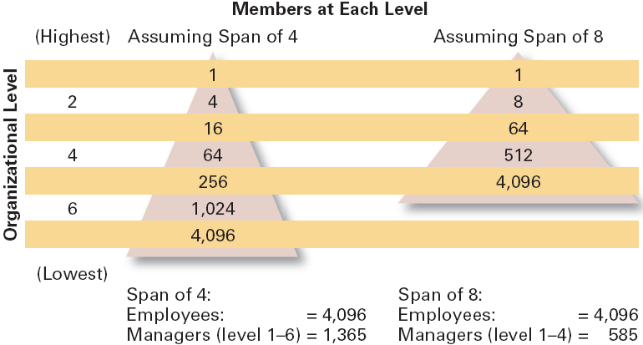
Contrasting Spans of Control

Slide 14
Organizational Structure (cont’d)
Centralization
  The degree to which decision making is concentrated at upper levels in the organization.
    Organizations in which top managers make all the decisions and lower-level employees simply carry out those orders.
Decentralization
  Organizations in which decision making is pushed down to the managers who are closest to the action.
Employee Empowerment
  Increasing the decision-making authority (power) of employees.

Slide 15
Factors that Influence the Amount of
Centralization and Decentralization
More Centralization
  Environment is stable.
  Lower-level managers are not as capable or experienced at making decisions as upper-level managers.
  Lower-level managers do not want to have a say in decisions.
  Decisions are relatively minor.
  Organization is facing a crisis or the risk of company failure.
  Company is large.
  Effective implementation of company strategies depends on managers retaining say over what happens.

Slide 16
Factors that Influence the Amount of Centralization and Decentralization
More Decentralization
  Environment is complex, uncertain.
  Lower-level managers are capable and experienced at making decisions.
  Lower-level managers want a voice in decisions.
  Decisions are significant.
  Corporate culture is open to allowing managers to have a say in what happens.
  Company is geographically dispersed.
  Effective implementation of company strategies depends on managers having involvement and flexibility to make decisions.

Slide 17
Organizational Structure (cont’d)
Formalization
  The degree to which jobs within the organization are standardized and the extent to which employee behavior is guided by rules and procedures.
    Highly formalized jobs offer little discretion over what is to be done.
    Low formalization means fewer constraints on how employees do their work.

Slide 18


Mechanistic Versus Organic Organization
• High specialization
• Rigid departmentalization
• Clear chain of command
• Narrow spans of control
• Centralization
• High formalization
• Cross-functional teams
• Cross-hierarchical teams
• Free flow of information
• Wide spans of control
• Decentralization
• Low formalization

Slide 19
Contingency Factors
Structural decisions are influenced by:
  Overall strategy of the organization
    Organizational structure follows strategy.
  Size of the organization
    Firms change from organic to mechanistic organizations as they grow in size.
  Technology use by the organization
    Firms adapt their structure to the technology they use.
  Degree of environmental uncertainty
    Dynamic environments require organic structures; mechanistic structures need stable environments.

Slide 20
Contingency Factors (cont’d)
Strategy Frameworks:
  Innovation
    Pursuing competitive advantage through meaningful and unique innovations favors an organic structuring.
  Cost minimization
    Focusing on tightly controlling costs requires a mechanistic structure for the organization.

Slide 21
Contingency Factors (cont’d)
Strategy and Structure
  Achievement of strategic goals is facilitated by changes in organizational structure that accommodate and support change.
Size and Structure
  As an organization grows larger, its structure tends to change from organic to mechanistic with increased specialization, departmentalization, centralization, and rules and regulations.

Slide 22
Contingency Factors (cont’d)
Technology and Structure
  Organizations adapt their structures to their technology.
  Woodward’s classification of firms based on the complexity of the technology employed:
    Unit production of single units or small batches
    Mass production of large batches of output
    Process production in continuous process of outputs
  Routine technology = mechanistic organizations
  Non-routine technology = organic organizations

Slide 23
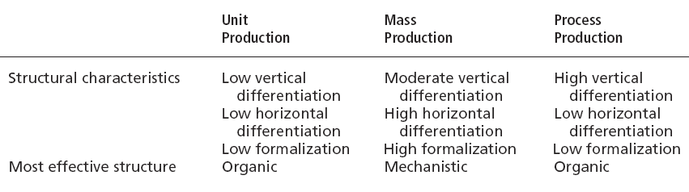
Woodward’s Findings on Technology,
Structure, and Effectiveness

Slide 24

Contingency Factors (cont’d)
Environmental Uncertainty and Structure
  Mechanistic organizational structures tend to be most effective in stable and simple environments.
  The flexibility of organic organizational structures is better suited for dynamic and complex environments.

Slide 25
Common Organizational Designs
Traditional Designs
  Simple structure
    Low departmentalization, wide spans of control, centralized authority, little formalization
  Functional structure
    Departmentalization by function
      Operations, finance, marketing, human resources, and product research and development
  Divisional structure
    Composed of separate business units or divisions with limited autonomy under the coordination and control the parent corporation.

Slide 26
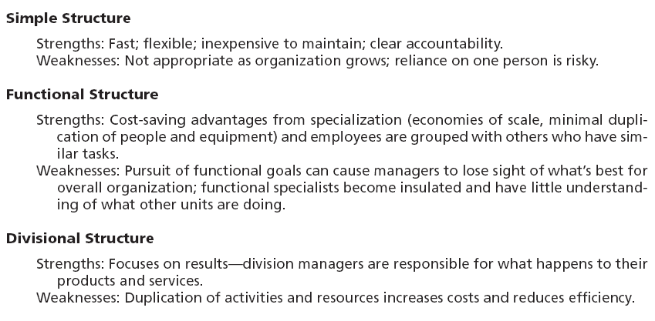
Strengths and Weaknesses of Traditional
Organizational Designs

Slide 27
Contemporary Organizational Designs
Team Structure
• What it is: | A structure in which the entire organization is made up of work groups or teams.
• Advantages: | Employees are more involved and empowered. Reduced barriers among functional areas.
• Disadvantages: | No clear chain of command. Pressure on teams to perform.
Matrix-Project Structure
What it is: | A structure that assigns specialists from different functional areas to work on projects but who return to their areas when the project is completed. Project is a structure in which employees continuously work on projects. As one project is completed, employees move on to the next project.
• Advantages: | Fluid and flexible design that can respond to environmental changes. Faster decision making.
• Disadvantages: | Complexity of assigning people to projects. Task and personality conflicts.

Slide 28
Contemporary Organizational
Designs
Boundaryless Structure
What it is: | A structure that is not defined by or limited to artificial horizontal, vertical, or external boundaries; includes virtual and network types of organizations.
• Advantages: | Highly flexible and responsive. Draws on talent wherever it’s found.
• Disadvantages: | Lack of control. Communication difficulties.

Slide 29
Removing External Boundaries
Virtual Organization
  An organization that consists of a small core of full-time employees and that temporarily hires specialists to work on opportunities that arise.
Network Organization
  A small core organization that outsources its major business functions (e.g., manufacturing) in order to concentrate on what it does best.
Modular Organization
  A manufacturing organization that uses outside suppliers to provide product components for its final assembly operations.

Slide 30
Today’s Organizational Design Challenges
Keeping Employees Connected
  Widely dispersed and mobile employees
Building a Learning Organization
Managing Global Structural Issues
  Cultural implications of design elements

Slide 31
Terms to Know
organizing
organizational structure
organizational chart
organizational design
work specialization
departmentalization
cross-functional teams
chain of command
authority
responsibility
unity of command
span of control
centralization
decentralization
employee empowerment
formalization
mechanistic organization
organic organization
unit production
mass production
process production
simple structure
functional structure
divisional structure
team structure
matrix structure
project structure
boundaryless organization
virtual organization
network organization
learning organization

